Slide 1

D.A. QUIZ!

Slide 2
1) Name a politician from the French Revolution

Slide 3
2) Which of these were leader(s) of the Cartaginian empire? A) Hannibal B) Scipio Africanus C) Askia D) Ramses II

Slide 4
3) Who famously said the words: “And yet, it moves”

Slide 5
4) What was the capital of the Aztec empire?
A) Cusco B) Texcoco C) Tenochtitlan D) Palenque

Slide 6
Geography

Slide 7
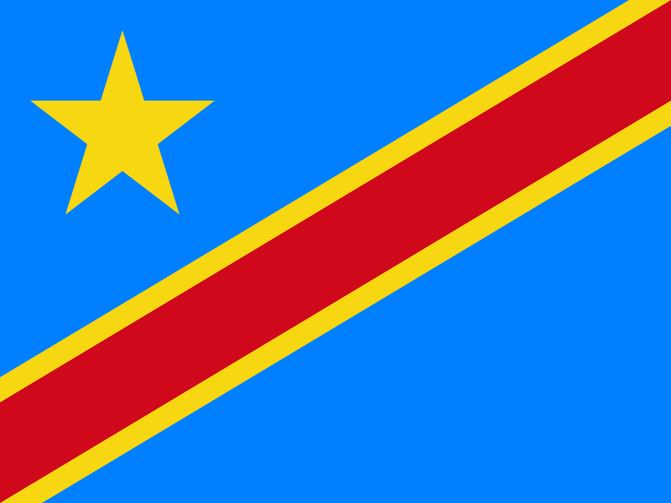
5) What country is this?

Slide 8
6) What is the highest mountain in Africa? Bonus point: In which country is it located?

Slide 9
7) China, India and the USA are the 3 most populated countries on Earth? Which 3 countries follow? 1 point for the 3 countries, 2 points for the correct order

Slide 10
8) What is the capital of New Zealand?

Slide 11
Art

Slide 12
9) Who composed the piece “Rondo alla Turca”?

Slide 13
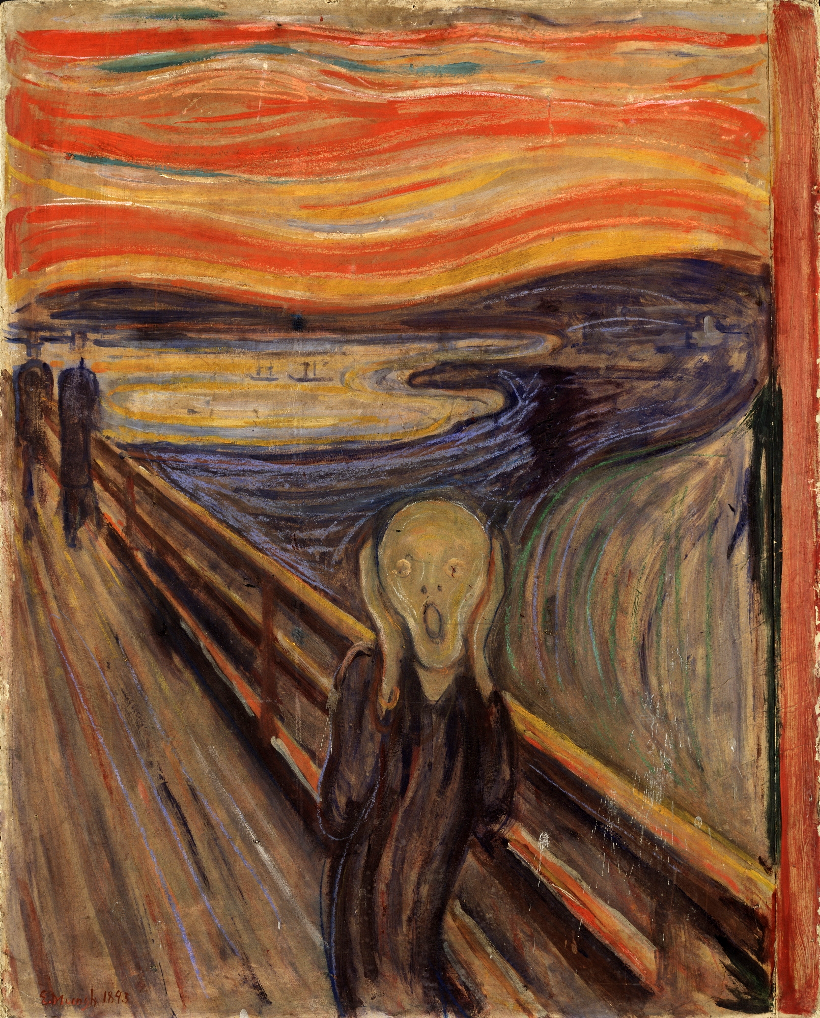
10) Find the artist!

Slide 14
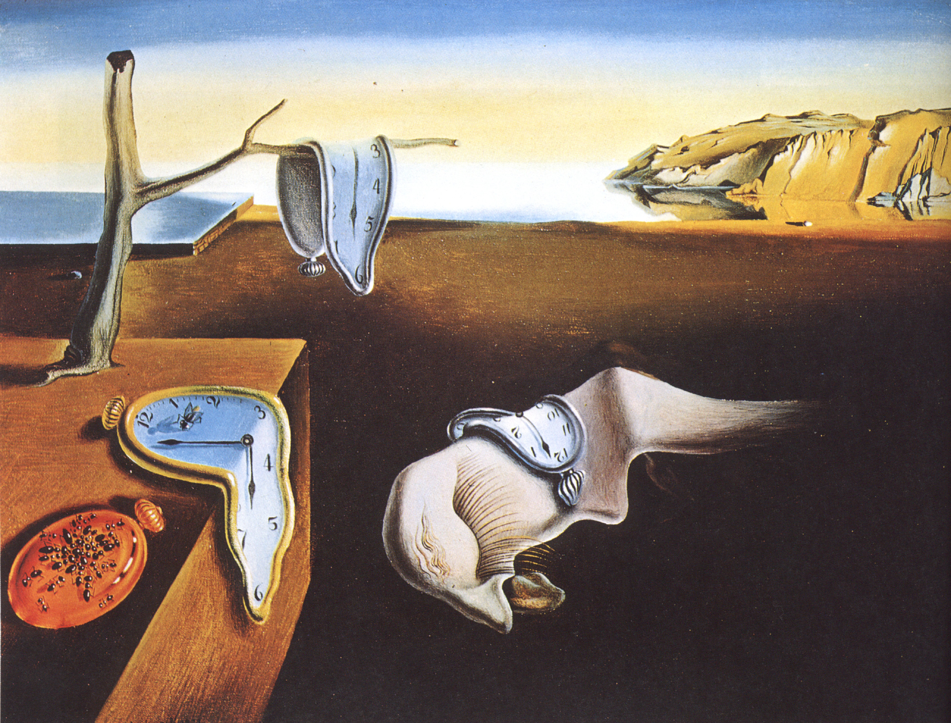
11)

Slide 15
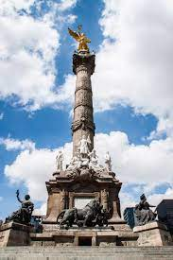
12) In which city is this monument located? What is its name?

Slide 16
RANDOM

Slide 17
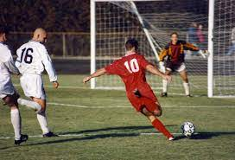
13) Which country hosted the first official Football World Cup?

Slide 18
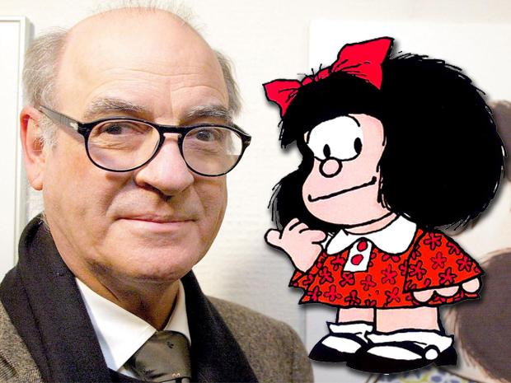
14) Who is this person?

Slide 19
15) Who was the first female Nobel prize winner?

Slide 20
16) What is the square root of the square of the product of 5 and √9

Slide 21
THE END

